Slide 1
D2.X LifeComp

Slide 2
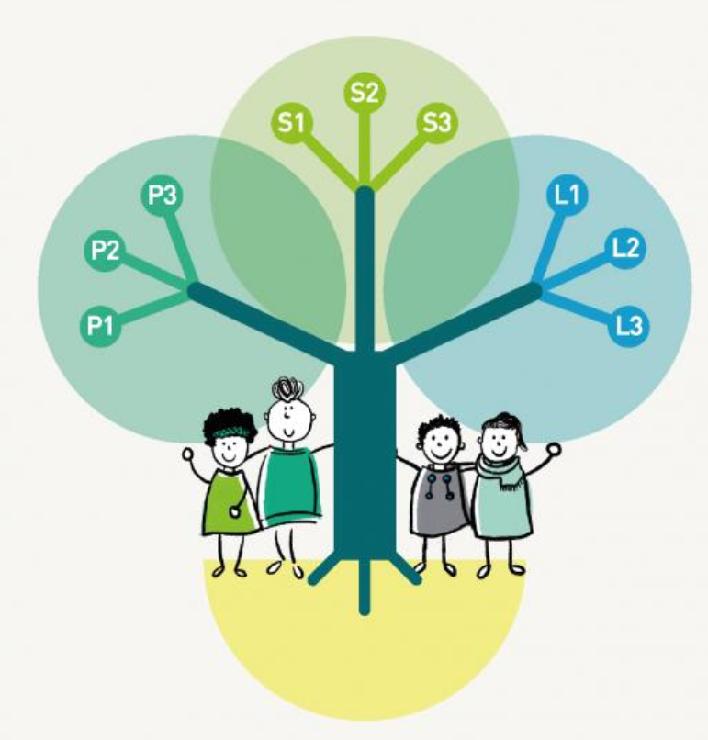
What is LifeComp
The “LifeComp Framework: Empowering Personal and Social Resilience” is a flexible reference framework developed by the European Commission to establish a shared language for transversal skills.
It focuses on the willingness to use specific skills in real-life situations, making it highly effective for behavioral change in vocational training.
Relevance for the MIND project → it provides the “soft skills” necessary for VET staff to support students facing psychological distresss and post-war challenges.
It consists of 3 interdependent areas and 9 specific competences essential for personal fulfillment and social inclusion.

Slide 3
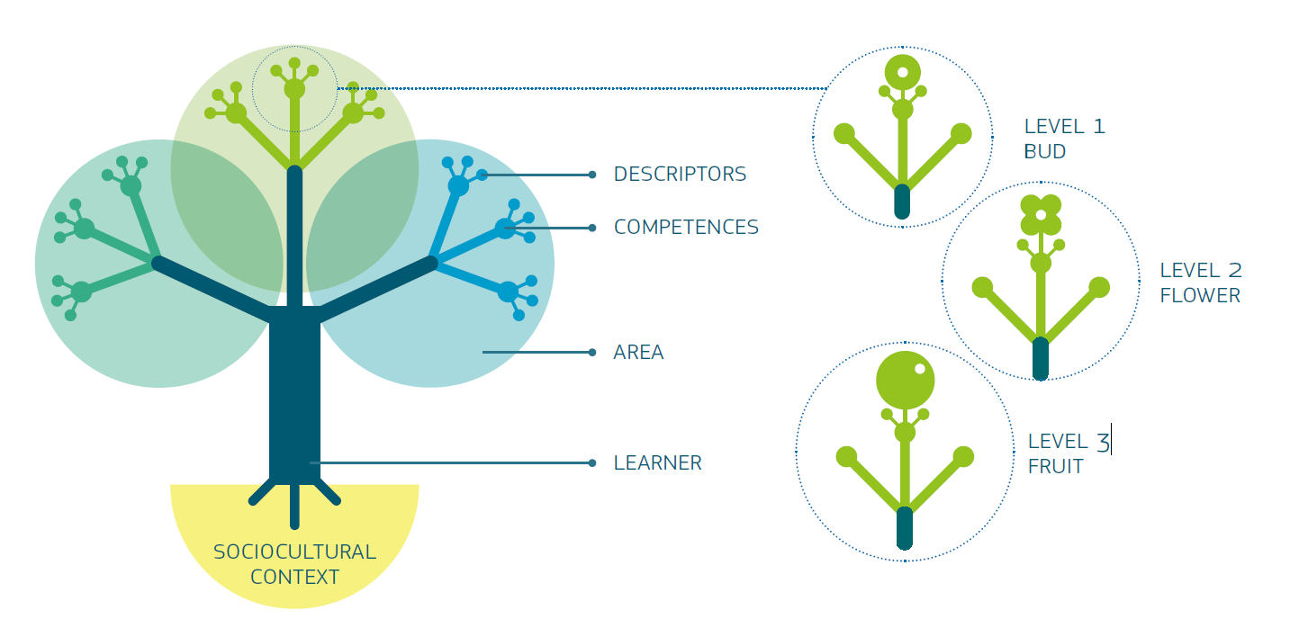
Visualisation of the framework
The framework is represented as a tree to emphasise that all competences are dynamically interdependent and develop over time. Roots symbolise the individual’s connection to sociocultural context and others, feeding overlapping branches, with every element equally necessary. Buds, flowers and fruits appearing simultaneously illustrate that different competences can coexist at different stages of progression.
Source: JRC SCIENCE FOR POLICY REPORT. The European Framework for Personal, Social and Learning to Learn Key Competence.

Slide 4

Visualisation of the framework
LifeComp is structured into areas, each containing three competences and each competence is described through three descriptors aligned to “awareness, understanding, action,” supported by icons for navigation.
The framework presents nine competences with definitions, using a tree metaphor to stress that personal development is shaped by sociocultural context and contextual enablers/constraints. It highlights the role of relationships in the microsystem (family, teachers, peers, etc.) and the broader macrosystem conditions (physical, social, cultural, economic, historical) underpinning competence development.
Source: JRC SCIENCE FOR POLICY REPORT. The European Framework for Personal, Social and Learning to Learn Key Competence.

Slide 5
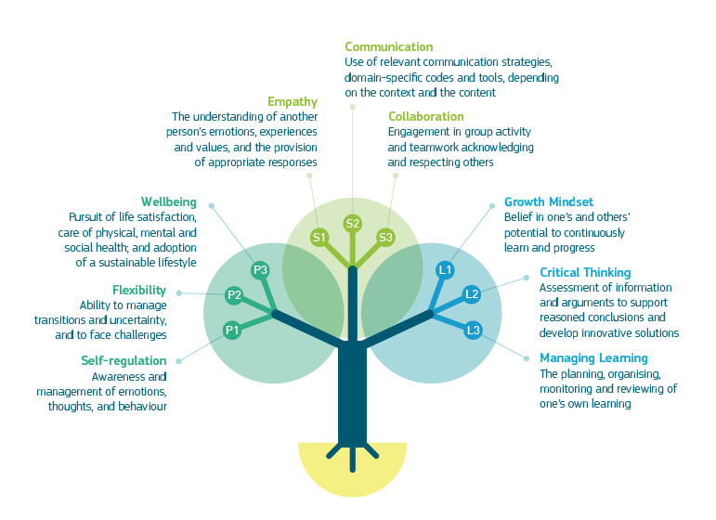
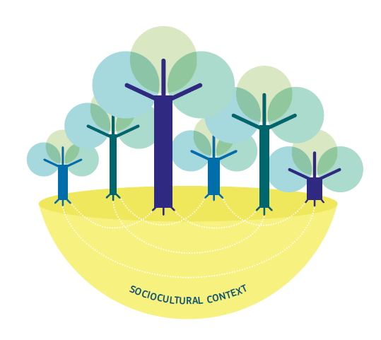
Visualisation of the framework
Source: JRC SCIENCE FOR POLICY REPORT. The European Framework for Personal, Social and Learning to Learn Key Competence.

Slide 6
The 3 Areas of LifeComp
These areas do not work in isolation. For a VET trainer, Self-regulation (Personal) is the prerequisite to effectively practicing Empathy (Social), which in turn creates the mental space for a student to engage in Critical Thinking (Learning to Learn).
Personal Area
Focuses on:
Self-regulation
Flexibility
Well-being
In your context, this helps trainers manage their own stress and prevent burnout while supporting students.
Social Area
Focuses on:
Empathy
Communication Collaboration
These are the "human tools" needed to understand and manage learners' distress and discomfort.
Learning to Learn Area
Focuses on:
Growth Mindset
Learning Management Critical Thinking
Crucial for the future reconstruction of Ukraine, enabling a proactive and innovative VET system.
The MIND project uses these areas to build the capacity of Ukrainian VET providers to foster inclusion and safety for distressed learners.

Slide 7
Area 1: Personal Competences
MIND Focus: essential for trainers to stay calm and effective when dealing with students' PTSD triggers.
Strengthening VET staff resilience to manage crisis and distress
Self-regulation
It is the “internal thermostat”. In crisis contexts, it helps staff manage cognitive load and emotional contagion.
Flexibility
The ability to pivot teaching strategies when external conditions (security, displacement) change abruptly.
Well-being
Defined as a proactive resource. It is not just the absence of stress, but the capacity to maintain a sense of purpose and physical health.
MIND Focus: adjusting teaching methods to the psychological needs of displaced or affected learners.
MIND Focus: preventing secondary traumatic stress and burnout among Ukrainian VET providers.

Slide 8
Area 2: Social Competences
MIND Focus: training VET staff to recognize signs of PTSD and psychological distress in students without judgment.
Fostering empathy and communication for trauma-informed VET
Empathy
Moving beyond “pity” to Social Perspective Taking. Understanding that a student's lack of focus is a physiological response to trauma.
Communication
Prioritizing “Active Listening”. In high-stress VET environments, silence and listening are as important as technical instructions.
Collaboration
Fostering a “Peer-Support” culture among VET staff to share the emotional weight of teaching in conflict zones.
MIND Focus: using "non-violent communication" to de-escalate tensions and provide supportive guidance to learners in crisis.
MIND Focus: building a strong network between VET teachers, psychological experts and local NGOs to create a holistic support system.

Slide 9
Area 3: Learning to Learn Competences
MIND Focus: helping VET staff and learners maintain a positive, forward-looking attitude despite the situation.
Empowering a proactive mindset for the reconstruction of Ukraine
Growth Mindset
The belief that neuroplasticity allows learners to recover and acquire new skills even after severe life disruptions.
Learning Management
Teaching students how to break down complex tasks into micro-goals to rebuild their sense of agency and control.
Critical Thinking
Helping students navigate misinformation and focus on evidence-based technical solutions for the future.
MIND Focus: adapting VET provision to align with new socio-economic dynamics and the needs of a country in reconstruction.
MIND Focus: equipping staff to evaluate and integrate innovative “mental health solutions" into traditional training.

Slide 10
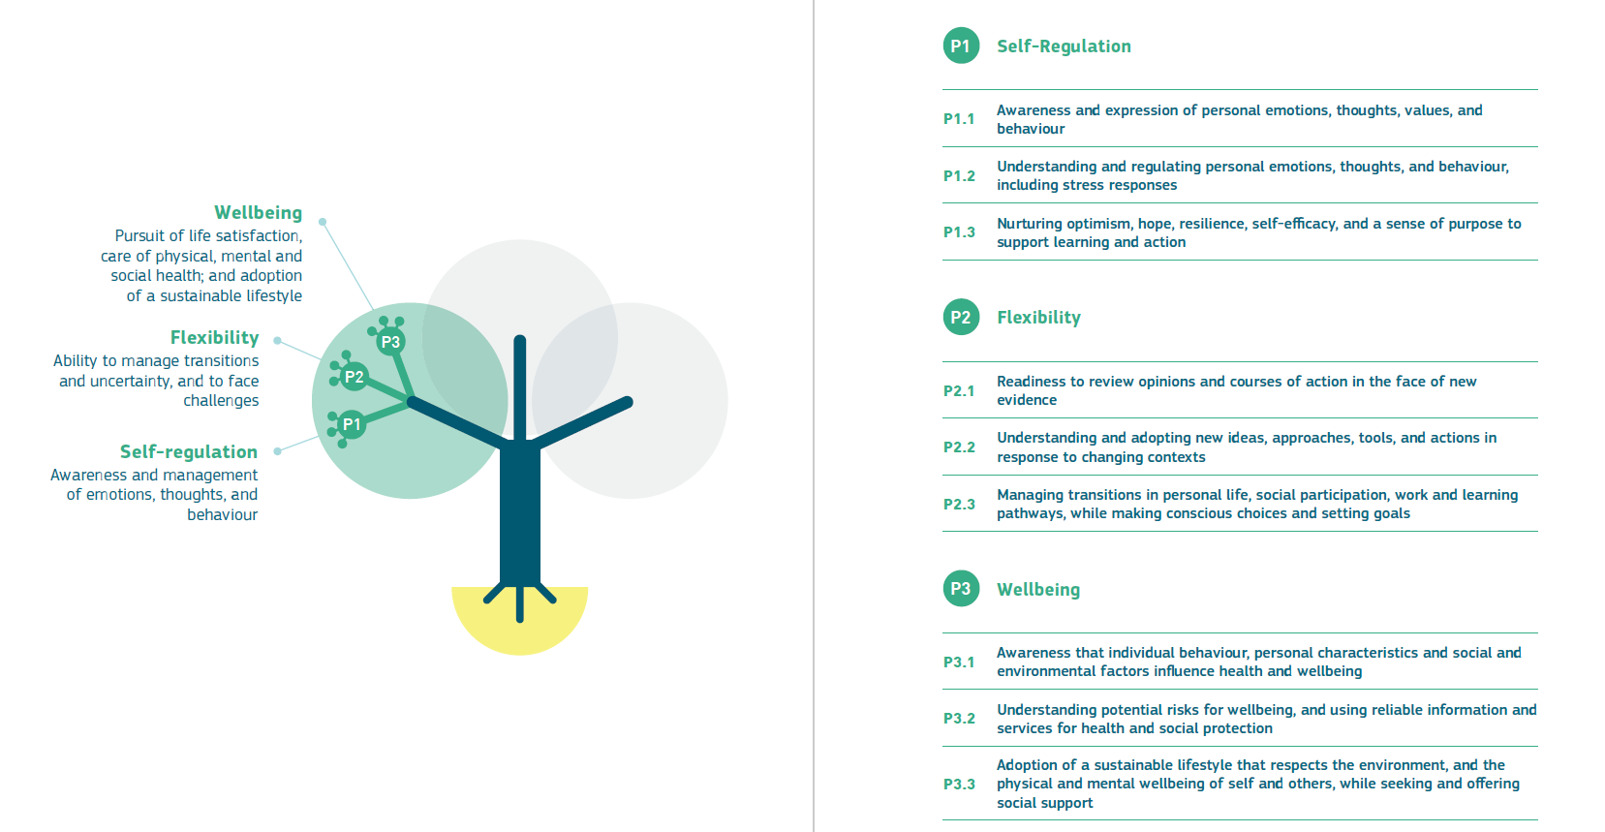
A closer look to the 1st area
Source: JRC SCIENCE FOR POLICY REPORT. The European Framework for Personal, Social and Learning to Learn Key Competence.

Slide 11
Exercise (pt 1)
Scenario
During a VET session, one participant becomes frustrated and interrupts, saying the activity is useless and a waste of time. The group reacts, time is limited and the trainer must regain control while keeping the session effective and inclusive.
Round 1: P1 Self-Regulation (P1.2)
Target competence: P1.2 → Understanding and regulating personal emotions, thoughts and behaviour, including stress responses.
Trainer task
Continue the interaction (do not shut the participant down). Apply ONE visible self-regulation strategy while responding (choose one): intentional pause/slower voice/grounded posture/controlled breathing/ brief internal self-talk. After a couple of minutes, re-structure the learning moment with ONE micro-action: 3-step mini-instruction or one guiding question.
Observer checklist (0-2 each; total 0-10)
Detects early stress signals and keeps a professional tone.
Selects an appropriate regulation strategy (not aggressive, not avoidant).
Applies it observably for ≥30 seconds (pace/voice/posture/pause).
Maintains functioning (listening, boundaries, clarity, inclusion).
Restores structure with a concrete micro-action that supports learning continuity.

Slide 12
Exercise (pt 2)
Round 2: P2 Flexibility (P2.1) + Round 3: P3 Wellbeing (P3.2)
Round 2 target competence: P2.1 → Readiness to review opinions and courses of action in the face of new evidence
New evidence (facilitator provides ONE at start of the round)
Half the class is online with unstable connection
Learners’ level is lower than expected
Materials/tools for the activity are not available
Only 10 minutes remain
Trainer task (2 minutes)
State what changes (1 sentence).
Change the plan immediately: stop 1 thing/simplify 1 thing/add 1 thing.
Set one immediate, realistic learning goal for the remaining time.
Observer checklist (0-2 each; total 0-6)
Updates at least one assumption and genuinely changes the plan.
Explains the reason for the change clearly and concretely.
Sets a feasible, measurable immediate goal.

Slide 13
Exercise (pt 3)
Round 3 target competence: P3.2 → Understanding potential risks for wellbeing and using reliable information and services for health and social protection.
Wellbeing trigger (facilitator adds at start of the round)
“The tension is spreading: multiple learners show overload (interruptions, frustration) and learning quality is dropping”.
Trainer task
Name 1 wellbeing risk in the group + 1 observable early sign.
Apply 1 immediate protective measure (pace/reset, communication rule, break the task into smaller steps, pair work).
Point to 1 reliable support pathway and a clear activation rule (“If X happens, we do Y”).
Observer checklist (0-2 each; total 0-6)
Identifies a specific risk and an observable early sign (not generic).
Implements a realistic protective measure that preserves inclusion and learning.
Names a credible support/resource and a clear “when to activate” criterion.
Debrief (a couple of minutes, after all rounds) → observer gives 1 strength + 1 micro-improvement per round. Trainer writes 3 lines: “P1 signal/strategy - P2 change made - P3 risk + support action”.

Slide 14
Worked Example (pt 1)
Scenario
During a hands-on classroom/lab session, a participant has a minor accident (a small cut). Some learners become anxious, others freeze. Time is limited and you must ensure safety, maintain learning continuity and keep the group inclusive.
ROUND 1: P1 Self-Regulation (P1.2: regulate your stress response while leading)
Visible self-regulation (immediately):
  Intentional pause (2-3 seconds), two slow breathing cycles, shoulders down, slower/steadier voice.
Containment + boundaries:
  “Pause. First we make this safe. I will coordinate”
Concrete micro-structure (restore control without shutting people down):
  Assign quick roles: “You, please bring the first-aid kit. You, create space and help X sit down. Everyone else, step back and stay where you are”
  Safety check: “Confirm there are no immediate hazards (tools on, sharp objects exposed, slippery surfaces)”
Minimal learning continuity:
  “30-second reset, then we continue with a simplified safe version of the activity”

Slide 15
Worked Example (pt 2)
ROUND 2: P2 Flexibility (P2.1: revise your plan based on new evidence)
New evidence (realistic constraint)
“The first-aid kit is not available in the room; you must contact the responsible person/escort the learner to the medical point. Only 15 minutes remain”
What I do/say
State what changes (one sentence): “given this new information, we stop the full practical task today, safety and an orderly close come first”.
Immediate plan change: stop 1/simplify 1/add 1
Stop: “We stop the full hands-on practice”
Simplify: “We switch to a guided demonstration: I show the steps, you note critical points and common errors”
Add: “We add a short “pre-task safety checklist” we will use from next session”
Set an immediate measurable goal:
At the end: everyone can name 3 operational risks and 3 safety checks before starting the practical task.

Slide 16
Worked Example (pt 3)
ROUND 3: P3 Wellbeing (P3.2: wellbeing risks + reliable support pathways)
Wellbeing trigger
“Tension remains high: some learners blame the injured participant, others look overwhelmed; attention drops.”
What I do/say (2 minutes)
Identify a wellbeing risk + one observable early sign:
  Risk: group anxiety/escalation and a blaming climate.
  Early sign: interruptions, raised voices, accusatory comments, visible agitation, disengagement.
Apply one immediate protective measure (without over-psychologizing):
  “60-second reset: slow breathing and silence. Then one rule: no blame, only facts and safety”
  “Restructure the activity: pair work on a quick sheet: what I observed, which safety check I will do next time”
Name a reliable support pathway + a clear activation rule (If X, then Y):
  “If anyone feels too activated to continue (shaking, nausea, tears, inability to focus), they can step out for 2 minutes and contact the course support/safeguarding contact/student support”
  “If the injury worsens or there are medical concerns, we activate the site protocol immediately (medical point/emergency contact + incident reporting)”
Final 3-line debrief (what the participant writes)
P1: My early stress signal was ________. My regulation strategy was ________.
P2: The new evidence was ________. The plan change I made was ________.
P3: The wellbeing risk was ________. The support action/activation rule was ________.

Slide 17
Thank you!

