Slide 1
D2.5 EU Competence Frameworks Training – EntreComp

Slide 2
EntreComp: Turning ideas into action
EntreComp is the European framework that helps people develop an entrepreneurial mindset, which refers to the ability to create value for others, in their work, community or daily life. It is not about starting a business, but about thinking creatively, taking initiative and making ideas happen.
It helps VET teachers and learners to
Think beyond technical skills
Connect classroom learning with real-life challenges
Build confidence, creativity, and initiative. In changing labour markets, being entrepreneurial means being ready for opportunities, adaptable and proactive in any profession

Slide 3
The three areas of EntreComp
EntreComp is structured around 3 main areas that represent the journey from idea to impact:
Ideas & Opportunities
spotting needs, imagining solutions, creating value
Resources
using skills, time and support to make ideas real
Into Action
turning plans into action and learning from experience
Each of these split in 5 specific competences, each composed of different threads describing the competence and associated to learning outcomes across 8 progression levels

Slide 4
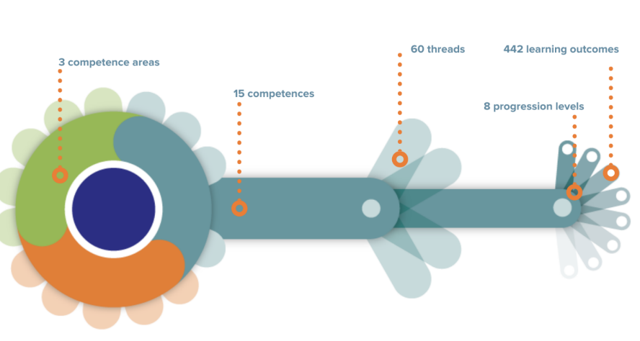
EntreComp - a visual representation
Source: EntreComp a practical guide, 2020

Slide 5
The 15 competences (5 per area) and their key threads
Ideas & Opportunities | Spotting Opportunities | a) Identify needs and challenges, b) Observe and listen actively; c) Analyse context and trends; d) Search for creative opportunities; e) Seize chances to create value
 | Creativity | a) Think divergently and imaginatively; b) Combine knowledge and resources in new ways; c) Experiment with ideas; d) Use creative techniques; e) Embrace curiosity and playfulness
 | Vision | a) Imagine a desirable future; b) Define long-term goals; c) Inspire others through purpose; d) Communicate ambition clearly; e) Translate vision into achievable aims
 | Valuing Ideas | a) Recognise the potential value of ideas; b) Evaluate impact and feasibility; c) Compare and select promising options; d) Protect and share ideas responsibly; e) Learn to justify and prioritise choices
 | Ethical & Sustainable Thinking | a) Assess the consequences of actions; b) Think long-term and systemically; c) Promote fairness, inclusion, sustainability; d) Make decisions based on ethics and integrity; e) Act responsibly toward people and planet

Slide 6
The 15 competences (5 per area) and their key threads
Resources | Self-Awareness & Self-Efficacy | a) Recognise one’s strengths and limits; b) Build confidence through experience; c) Set personal learning goals; d) Reflect on performance; e) Seek feedback and growth
 | Motivation & Perseverance | a) Stay committed to goals; b) Keep focus under pressure; c) Overcome obstacles and setbacks; d) Manage emotions constructively; e) Turn challenges into learning opportunities
 | Mobilising Resources | a) Identify and use available resources; b) Obtain support, tools, and materials; c) Make effective use of time; d) Build partnerships and networks; e) Manage constraints creatively
 | Financial & Economic Literacy | a) Understand value creation and cost; b) Manage budgets and resources; c) Assess financial risks and returns; d) Make responsible economic decisions; e) Understand the basics of sustainability economics
 | Mobilising Others | a) Communicate effectively and persuasively; b) Build trust and empathy; c) Inspire and involve others; d) Lead collaboratively; e) Share vision and coordinate efforts

Slide 7
The 15 competences (5 per area) and their key threads
Into Action | Taking the Initiative | a) Act independently and proactively; b) Take responsibility for decisions; c) Pursue opportunities with energy; d) Learn by doing; e) Move from intention to action
 | Planning & Management | a) Set goals and priorities; b) Design step-by-step plans; c) Allocate tasks and time effectively; d) Monitor progress and adapt plans; e) Balance short- and long-term objectives
 | Coping with Uncertainty, Ambiguity & Risk | a) Identify and assess risks; b) Tolerate uncertainty; c) Make decisions with limited information; d) Learn from mistakes; e) Stay calm and adaptive in change
 | Working with Others | a) Collaborate in teams; b) Share responsibility; c) Manage conflict constructively; d) Appreciate diversity; e) Support and empower peers
 | Learning Through Experience | a) Reflect on achievements and failures; b) Extract lessons from practice; c) Adapt and improve performance; d) Share knowledge with others; e) Apply learning to new contexts

Slide 8
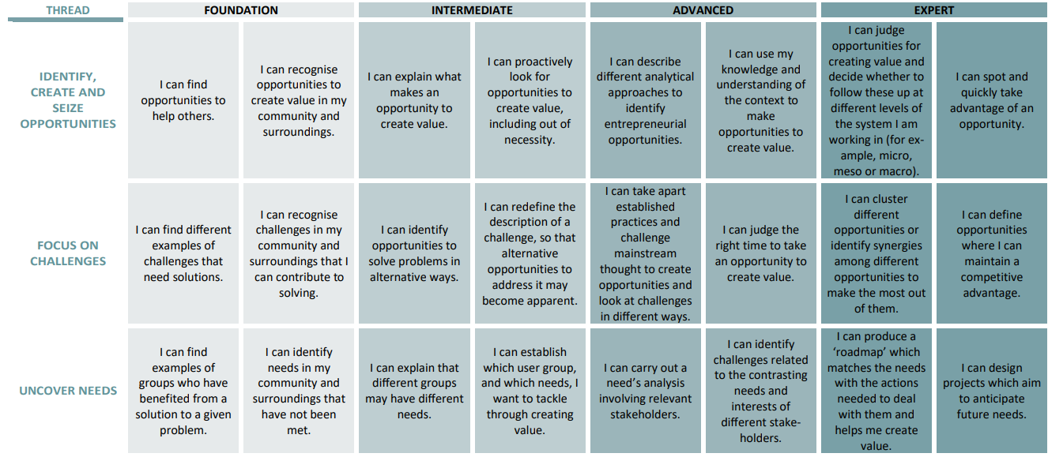
The progression levels – an example from the “Spotting opportunities” competence
Source: EntreComp a practical guide, 2020
Notes:
Source: EntreComp a practical guide, 2020

Slide 9
What it means to be entrepreneurial
To be entrepreneurial means to:
See problems as opportunities
Take responsibility instead of waiting for instructions
Learn from mistakes and try again
Work with others and turn ideas into action
Entrepreneurship → life skill for everyone (students, teachers, citizens)

Slide 10
Examples from the classroom
EntreComp fits easily into everyday teaching. Examples:
A group project = working with others
A student proposing a new activity = taking the initiative
A teacher who asks students to reflect on what went well and what did not
= learning through experience
Small steps like these bring entrepreneurial learning to life.

Slide 11
Benefits for VET trainers
Using EntreComp helps teachers to:
Motivate students and make learning more dynamic
Support transversal skills such as teamwork, communication, and creativity
Connect lessons with community or workplace needs
Build bridges between technical skills and personal development

Slide 12
Benefits for learners
Learners who use EntreComp:
Feel more confident to express their ideas
Learn to plan and organise their work
Develop resilience when facing difficulties
Understand how their learning creates value for others
Learners → change-makers

Slide 13
How to start with EntreComp in your school
EntreComp is flexible and easy to adapt. You do not need to redesign your curriculum, you might start from what you already have in place. Here are four simple steps you can use to introduce entrepreneurial learning in your VET institution:
Identify what is already there
Review your classes and activities. Many of them already include EntreComp competences (teamwork, creativity, problem-solving, communication)
Select one focus competence
Choose one competence to strengthen (e.g. taking the initiative or learning through experience).
You can consult all 15 competences, with definitions and progression levels
Design one small activity
It can be part of an existing lesson. Examples: group challenges, idea generation tasks or mini-projects that connect technical learning with real needs
Reflect and share
End the lesson with one reflection question such as “What did I learn by doing?” or “What would I do differently next time?”
It helps learners understand how competences grow through experience

Slide 14
EntreComp in key VET sectors
Below there are three sector-based examples that VET trainers can use immediately in class.
Construction / Technical Trades Scenario: “Your workshop must improve safety and reduce time lost due to disorganised tools and materials.”
EntreComp competences most visible: taking the initiative (start improvements without waiting); planning & management (steps, roles, timeline); mobilising resources (use existing space/tools more efficiently); ethical & sustainable thinking (safety, responsibility).
Quick exercise: create a 3-step action plan + 2 indicators (e.g., time saved, incidents avoided).
ICT / Digital Services
Scenario: “Design a simple digital solution to improve a school process (room booking, issue reporting, internal communication).”
EntreComp competences most visible: spotting opportunities (identify the real need); vision (what “better” looks like for users); coping with uncertainty & risk (requirements change; privacy constraints); mobilising others (collect feedback).
Quick exercise: build a mini canva: users → problem → solution → risks → test plan.
Hospitality / Culinary
Scenario: “Improve customer experience while reducing food waste and cost in a training restaurant.” EntreComp competences most visible: creativity (new ideas for menu/service); valuing ideas (compare options with clear criteria: cost, time, quality); working with others (roles in service and kitchen); learning through experience (reflect after service: what worked/what to improve).
Quick exercise: create a service improvement card: idea → criteria → plan → reflection question.
Which sector is closest to your programme? Choose one scenario and identify 3 EntreComp competences you already teach, even if you do not call them “entrepreneurship”.

Slide 15
Mini practical exercise: EntreComp in action
This exercise helps both teachers and learners understand the logic of the framework: from ideas → to resources → to action.
Step-by-step activity:
Think of one improvement you could make in your school or training centre (e.g. a recycling corner, a digital notice board, a small event).
EntreComp Area 1: Ideas & Opportunities.
List what you already have. Identify available resources (people, tools, time, spaces, knowledge) and what is missing.
EntreComp Area 2: Resources.
Plan three concrete actions you could take this month. Define who does what, when and how you will check results.
EntreComp Area 3: Into Action.
Reflect together. Which competences did you use? (Creativity? Mobilising others? Learning through experience?)
What challenges did you face, and how did you overcome them?
What value did your idea create for others?

Slide 16
Thank you!

