Slide 1
D2.5 EU Competence Frameworks Training – DigComp

Slide 2
What is DigComp 3.0
DigComp 3.0 is the European Digital Competence Framework for Citizens, developed by the Joint Research Centre (JRC) of the European Commission.
It provides a common European reference for describing digital competences in terms of knowledge, skills and attitudes, structured into 5 competence areas, 21 competences and 8 proficiency levels.
DigComp 3.0 is:
Competence-based
Learning-outcomes-oriented
Transversal and sector-neutral
Applicable across education, VET, employment and lifelong learning
It does not prescribe curricula, but offers a shared language and structure to design, deliver and assess digital competences.

Slide 3
What benefit DigComp provides
Benefits for VET Providers and Trainers
Provides a clear and shared framework to define digital competences
Supports coherent curriculum design across courses and programmes
Helps avoid fragmented or ad-hoc digital skills teaching
Enables alignment with other EU frameworks (EQF, ESCO, Europass, EQAVET)
Benefits for Mental-Health Education and Training
Strengthens competences related to:
Safe digital communication
Online collaboration
Digital well-being and self-regulation
Data protection and privacy
Responsible use of digital tools
Supports ethical and safe digital practices in counselling, mentoring and learner support.
Benefits for Learners
Improves employability and adaptability
Enhances autonomy and responsibility in digital environments
Supports inclusion and participation
Promotes awareness of digital well-being and safety

Slide 4
What benefit DigComp provides
Integration During Course Design
DigComp competences should be integrated from the beginning, when designing a course or training module
Step 1: Identify Relevant DigComp Areas
Not all courses need all 21 competences. Trainers should identify which areas are relevant to the course objectives.
Example (mental-health training):
Communication and Collaboration
Safety
Information and Data Literacy
Step 2: Select DigComp Competences
Choose specific competences from the selected areas that support the course goals. Example:
Managing digital identity
Protecting personal data
Communicating respectfully in digital environments
Step 3: Define Learning Outcomes
Translate DigComp competences into course-specific learning outcomes, using learning-outcome language.
Example: “Learners are able to communicate with peers and clients using digital tools in a safe, ethical and respectful way”
Step 4: Align with Proficiency Levels
Decide which DigComp proficiency level is expected (foundation, intermediate, advanced).
This ensures:
Realistic expectations
Coherence with learner profile
Transparency of competence development

Slide 5
What benefit DigComp provides
B. Integration During Assessment
DigComp 3.0 supports competence-based assessment, not just knowledge testing
Step 1: Assess Application, Not Theory
Assessment should verify whether learners can:
Apply digital tools
Behave responsibly online
Manage risks and well-being
Step 2: Use Authentic Assessment Methods
Examples aligned with DigComp:
practical tasks scenario-based exercises simulations
reflective journals
digital portfolios
Step 3: Assess Autonomy and Responsibility
DigComp proficiency levels explicitly include:
degree of autonomy
responsibility in digital contexts
Assessment should therefore consider:
independent decision-making
responsible behaviour
awareness of digital impact on self/others
Step 4: Provide Feedback Linked to DigComp
Feedback should explicitly reference:
DigComp competence area
competence level
strengths and improvement areas

Slide 6
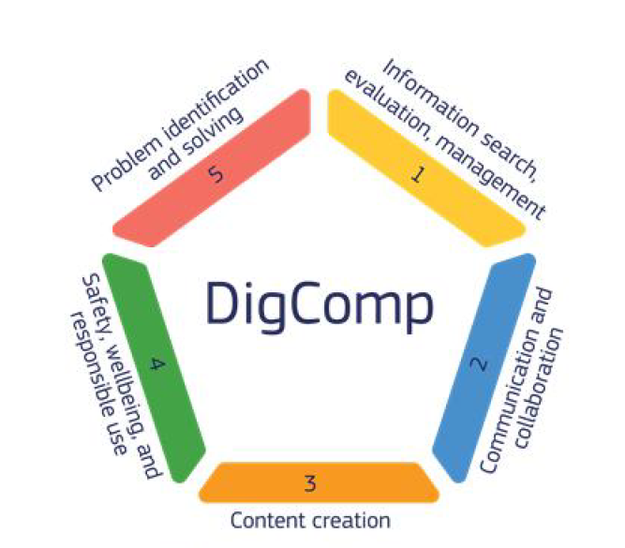
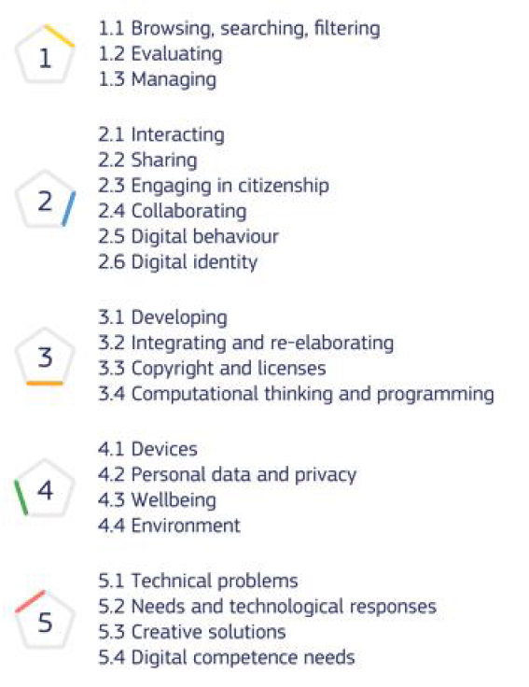
DigComp 3.0: Competence Areas & Competences

Slide 7
Two Different Frameworks, Two Different Targets
When talking about digital competences in education and training, it is important to clearly distinguish between DigComp 3.0 and DigCompEdu. Although they are often mentioned together, they are two different European frameworks with different purposes and target groups.
DigComp 3.0
The European Digital Competence Framework for Citizens
Focus: all citizens
DigCompEdu
The European Framework for the Digital Competence of Educators
Focus: educators and trainers
They are complementary but not interchangeable frameworks

Slide 8
DigCompEdu: What It Is
DigCompEdu defines the digital competences educators need to support learners’ digital development.
It describes:
6 competence areas
22 educator-specific competences
A progression model from Newcomer to Pioneer
Target group:
Teachers
Trainers
Educators
Mentors
VET instructors
Purpose:
Support digital teaching and training
Improve pedagogical use of technology
Help educators empower learners’ digital competence

Slide 9
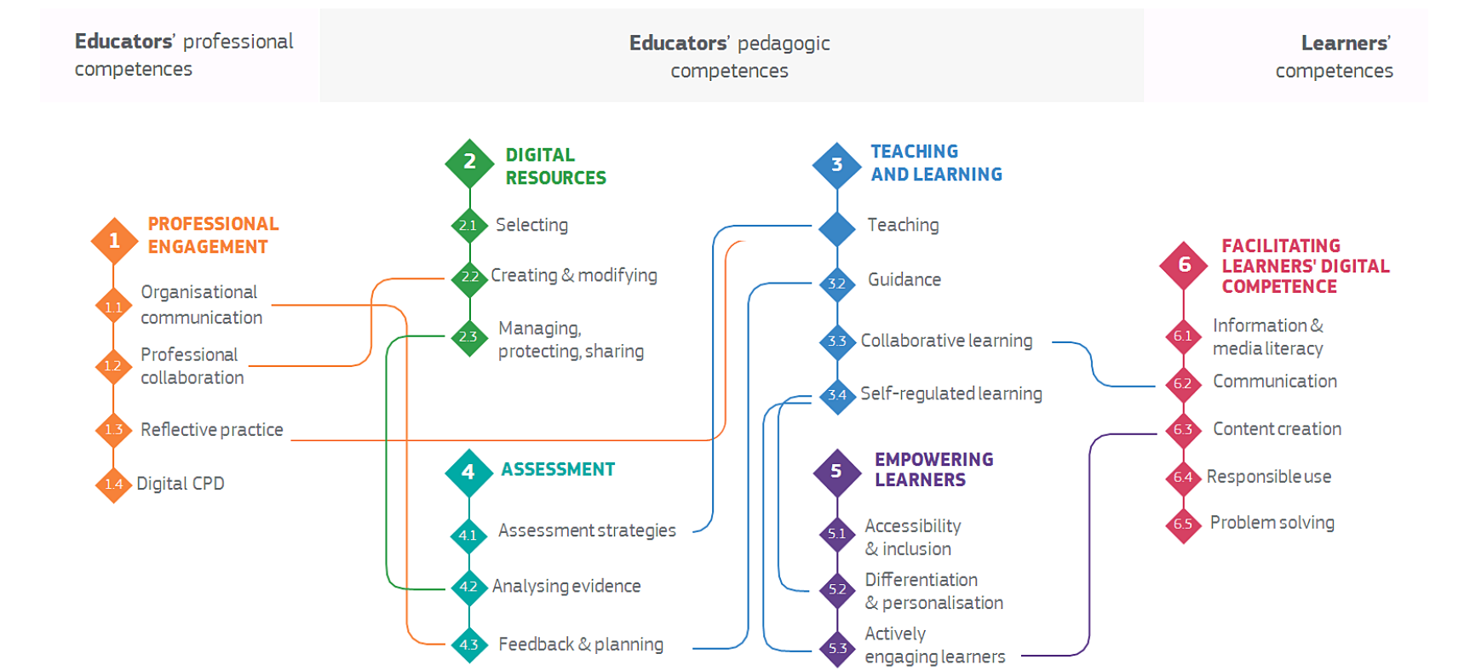
DigCompEdu Framework

Slide 10
How DigComp 3.0 & DigCompEdu work together in VET
DigComp 3.0 should be used when:
Defining learning outcomes for courses and training programmes
Integrating transversal digital competences into existing curricula
Supporting learners’ digital autonomy, safety and well-being
Assessing learners’ ability to use digital tools responsibly and effectively
DigCompEdu should be used when:
Training teachers, trainers, mentors and counsellors
Improving the pedagogical use of digital technologies
Designing digital or blended learning activities
Strengthening educators’ capacity to assess and support learners online

Slide 11
Exercise
Scenario
You are part of a VET institution that delivers a course for learners preparing to work in mental health support, counselling, mentoring or learner assistance. Your task is to redesign one module of this course by integrating transversal digital competences using DigComp 3.0.
PART 1: Selecting Relevant DigComp Areas
Instruction: review the five DigComp 3.0 competence areas and select at least one that is most relevant for your course.
Justification (why these areas are relevant for a mental-health VET course).
PART 2: Selecting DigComp Competences
Instruction: from the selected areas, choose 2-4 DigComp competences that best support the objectives of your course.
-DigComp Area
-Competence Name
-Why Important for this course.
PART 3: Defining Learning Outcomes (Course Design)
Instruction: translate the selected DigComp competences into course-specific learning outcomes.
-LO1: learners are able to…
-LO2: …
-LO3: …
-LO4: ...
- …
PART 4: Aligning with DigComp Proficiency Levels
Instruction: decide which DigComp proficiency level is appropriate for your learners.
Appropriate
Intermediate
Advanced
Justification.
PART 5: Designing Competence-Based Assessment
Instruction: define how you will assess whether learners have achieved the DigComp-based learning outcomes.
Learning Outcome
Assessment Method
What Is Assesed

Slide 12
Thank you!

